Slide 1
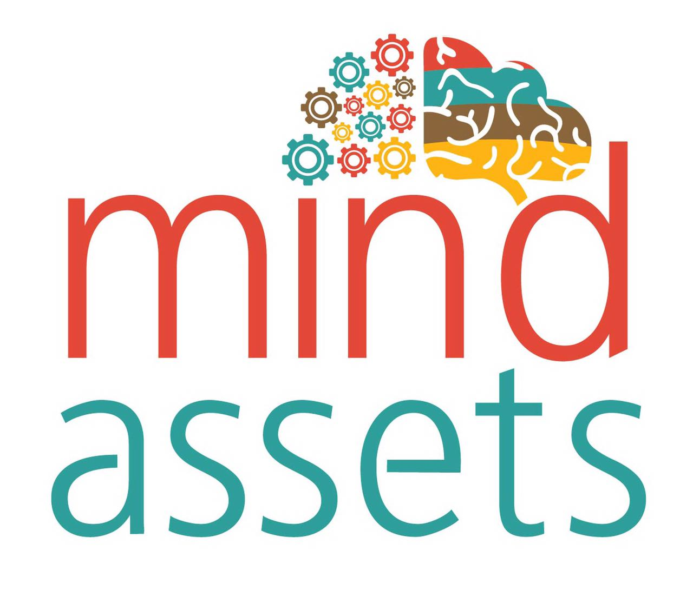

Slide 2
Who are we?
‘Mind Assets’ is an initiative to primarily create ‘Remote Working' opportunities for the differently-abled.
We ensure that physical challenge is not a barrier for the differently-abled by assisting them in fulfilling their ambitions.
In the near future, even qualified women, who cannot take on full time jobs due to their household responsibilities can use our platform

Slide 3
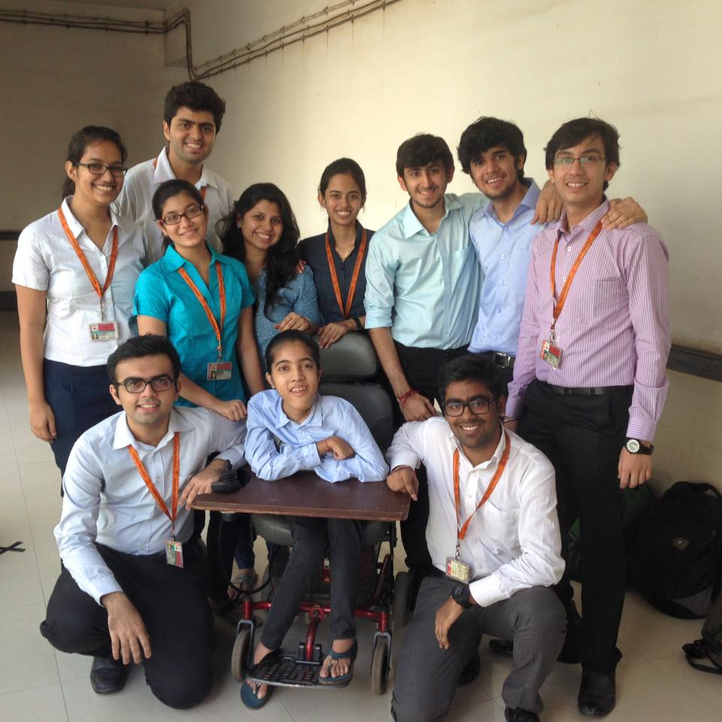
Where it all started…
During the campus placements, having cleared the interview process, I still could not join the company…
Due to inaccessibility for wheelchair users in the company. And this isn’t an uncommon circumstance for many…

Slide 4
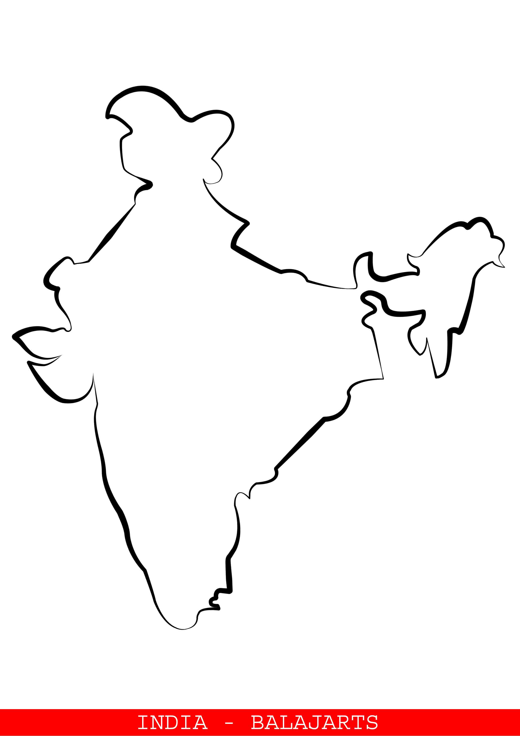
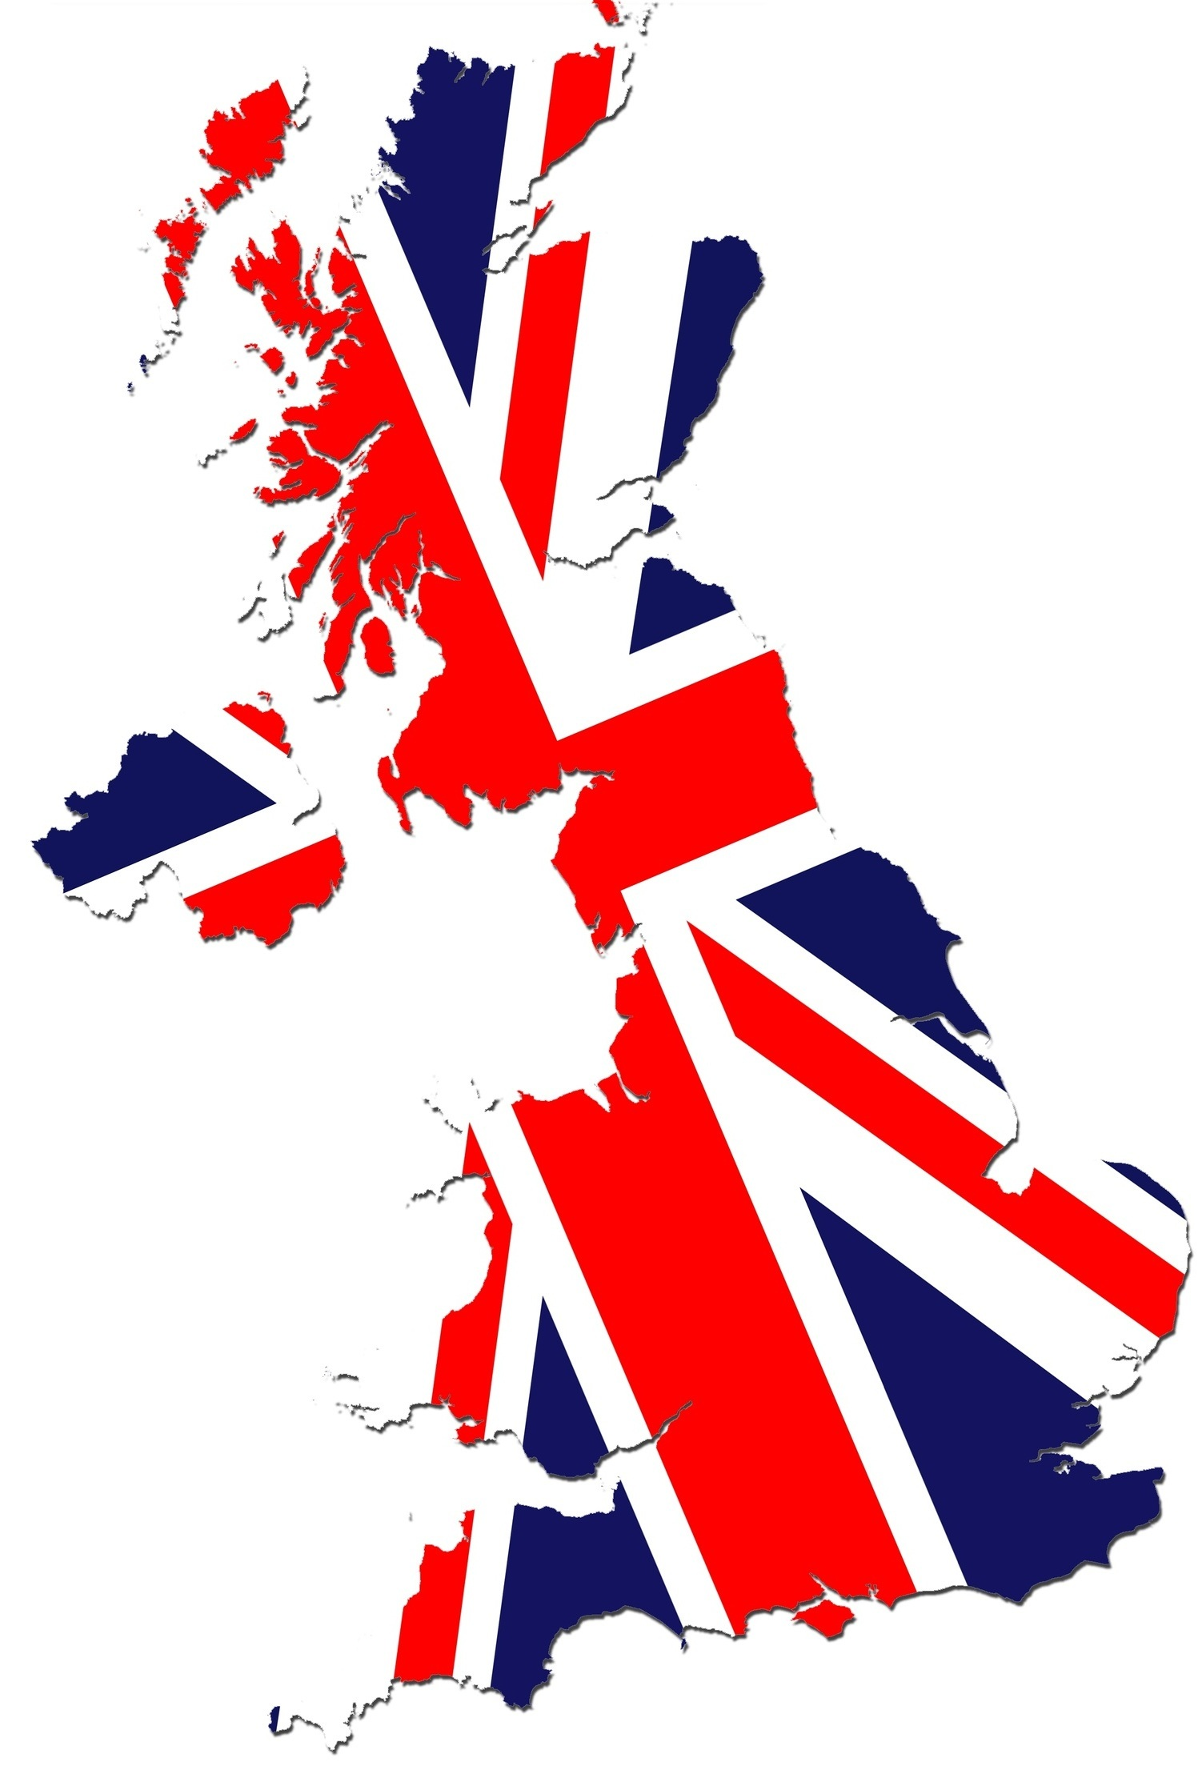
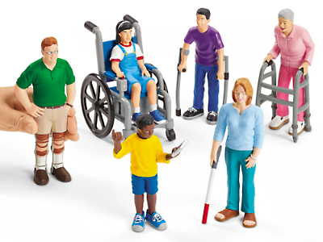
Magnitude of the Problem
Employable Differently-abled in India
Population of U.K.
Out of more than 150 million differently-abled in India, at least 70 million are of employable age but the cold and bitter truth is that 98% of them are unemployed.*
If 1% of them will take our service at ₹11,500, this can translate into a market potential of Rs. 805 crores. *NCPEDP Data

Slide 5
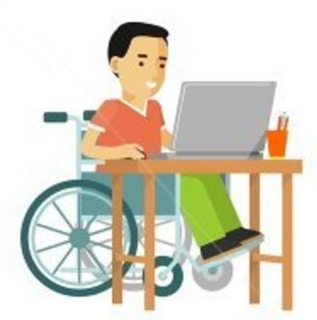
The Solution
online
Career Counselling
Technical Training
Certification
Pre-placement Process
Soft-Skill Training
Job Placements

Slide 6
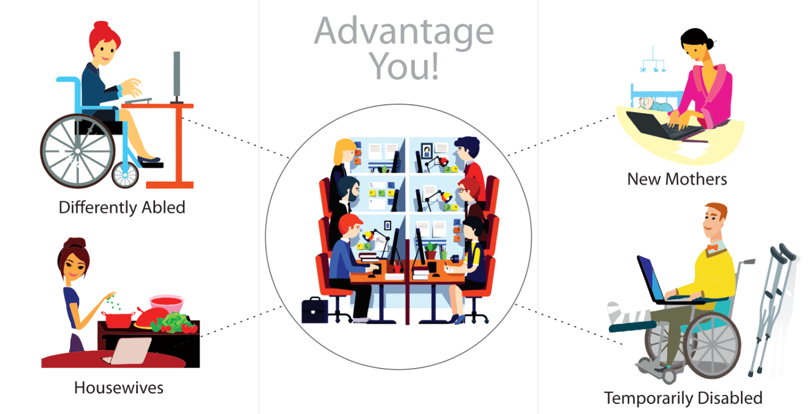

Slide 7
Various Job Profiles
HSC
Graduates
Hobbyists
Data Entry
File Conversion
Proofreading
Transcription
Documentation
and a few more…
Social Media Marketing
Ecommerce
Research and Summaries
CRM
and a few more…
Graphic Designing
Blog Writing
Sound and Video Editing
3D modelling
and a few more…

Slide 8
The Business Model
Mind Assets
Employer
Employee
Registration +
Training
+ Certification
Commission
Salary

Slide 9
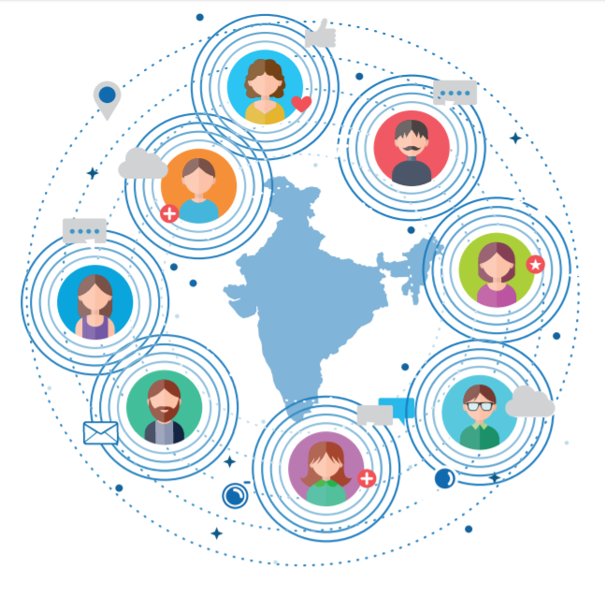
Concept Validation
Pilot
11 candidates
9
cities
5 trained
5 placed

Slide 10
Testimonials & Publications

Slide 11
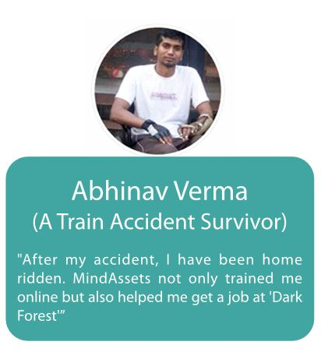
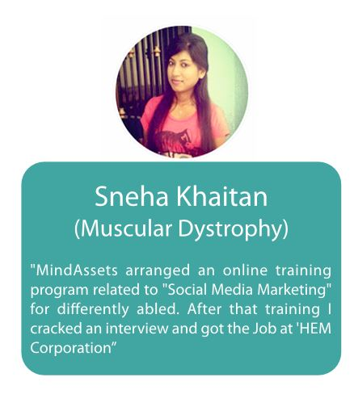

Slide 12
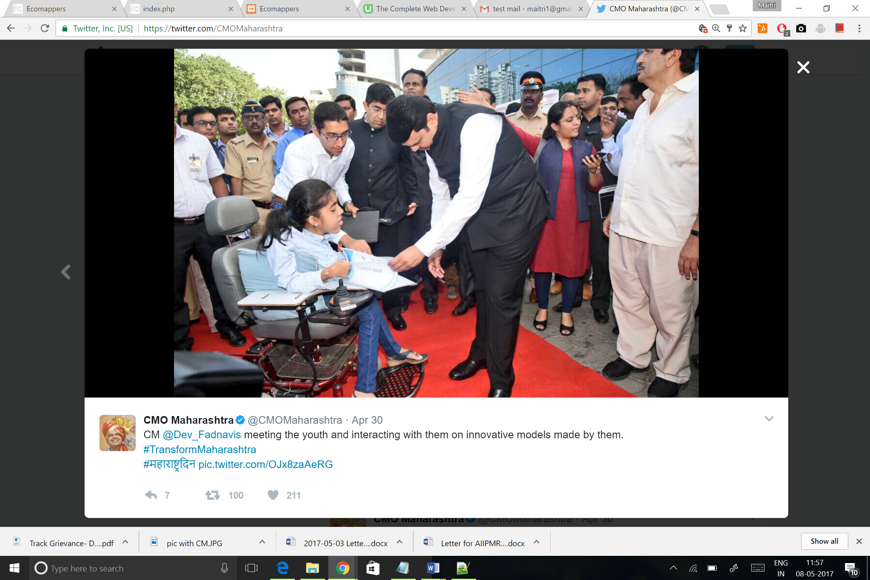

Interaction with Hon. CM of Maharashtra Mr. Devendra Fadnavis on an event ‘Transform Maharashtra’ organized on Maharashtra Day by GOI.

Slide 13
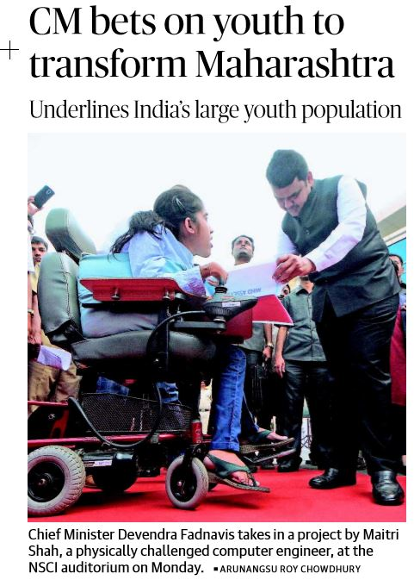
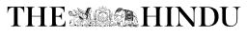

Slide 14
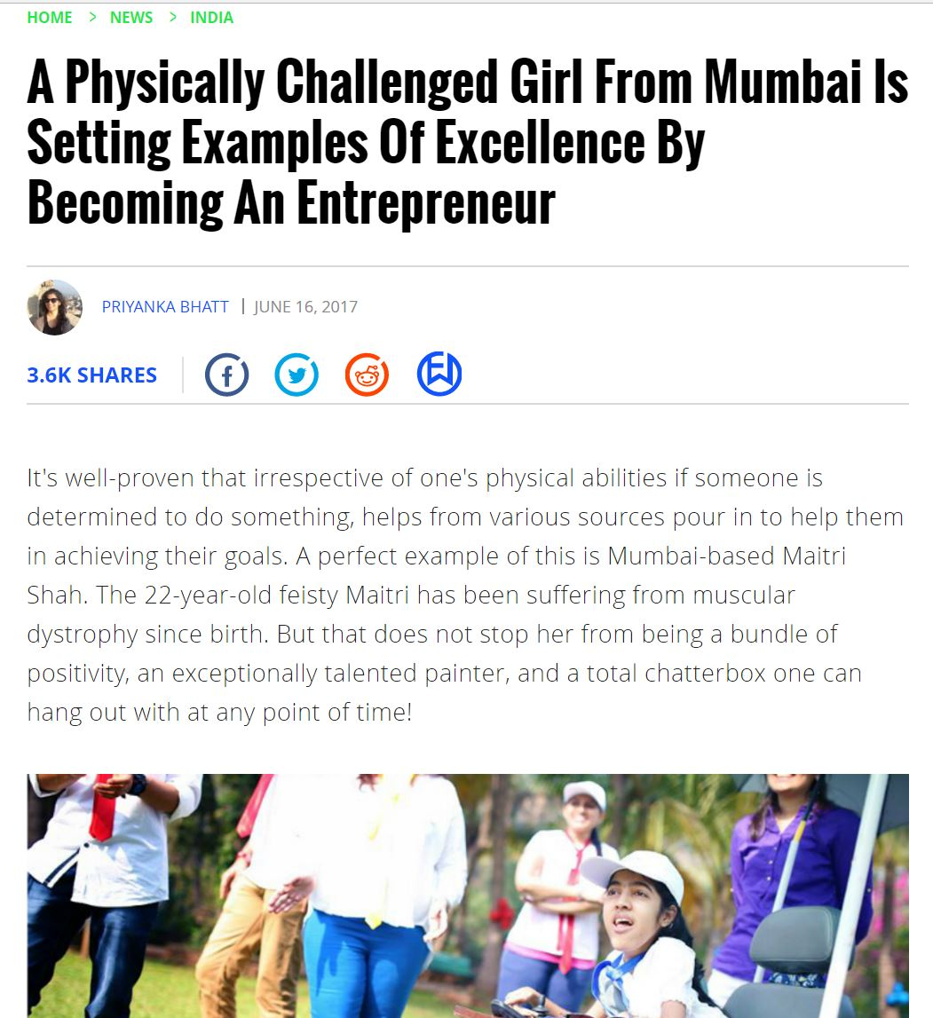
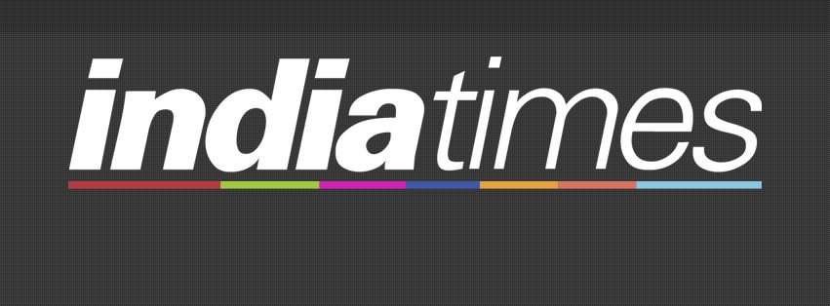

Slide 15
Thank You!

